Slide 1

Week1:
Introduction to Machine Learning
Machine Learning Using Tensorflow
Shu-Ting Pi, PhD
UC Davis

Slide 2
Goals of this course
Prerequisites of this course
  - familiar with Python, but new to machine learning (ML)
Philosophy of this course
  - Not to make you an “expert” on ML.
  - Just to make you an “user” of ML to solve problems
  - Will not cover too many theories about ML.
  - Only basic concepts will be introduced.
Course design
  - Discuss a few topics of ML every week.
  - Discuss a code implementation every week.
Machine Learning using Tensorflow
Shu-Ting Pi

Slide 3
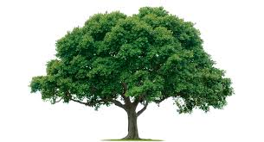
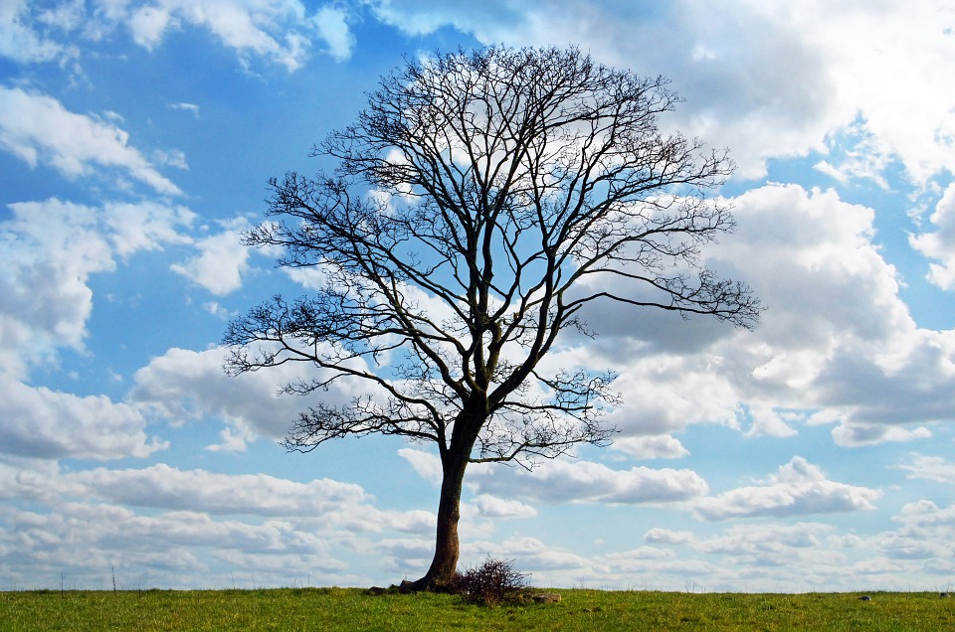
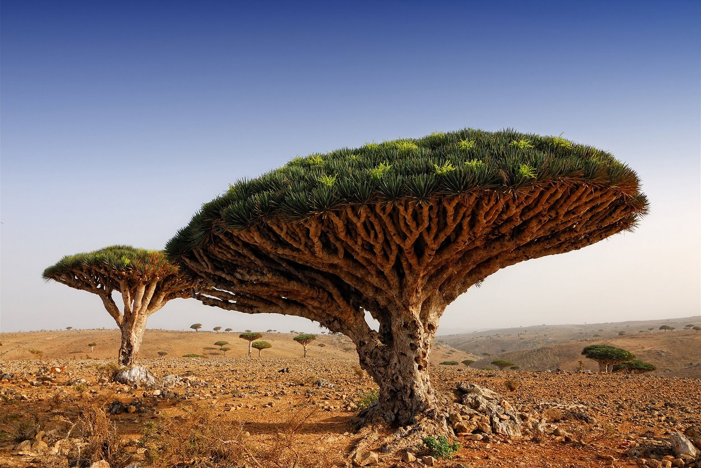
How do human learn?
Features !
Features !
Features !
Machine Learning using Tensorflow
Shu-Ting Pi

Slide 4
Types of machine learning
Supervised learning
  All data are labeled, answers can be compared
  Suitable for “regression, classification”
Unsupervised learning
  Data are not labeled, features are collected by machine
  Suitable for “clustering”
Reinforcement learning
  Between supervised and unsupervised: state, action, reward
  Suitable for “decision”
Machine Learning using Tensorflow
Shu-Ting Pi

Slide 5
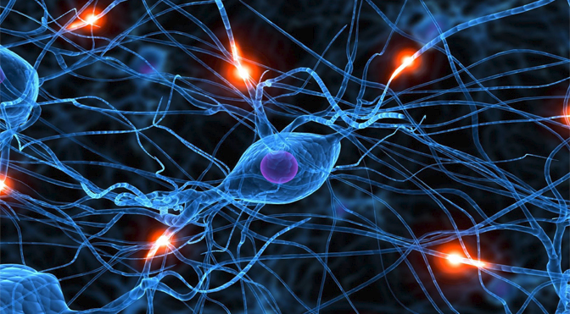
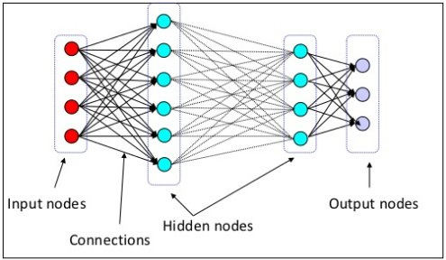
What is deep learning?
Deep learing <-> artificial neural network
Human neural network
Artificial neural network
Two key fetures:
“multilayer” and “non-linear”
(will explain in the future)
One concept:
Representing data using different ways and eventually extract the features
Machine Learning using Tensorflow
Shu-Ting Pi

Slide 6
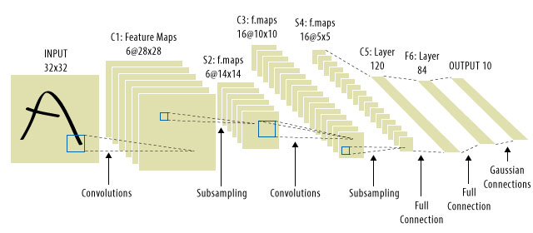
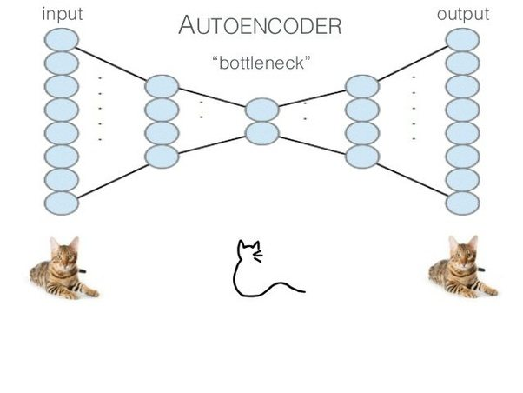
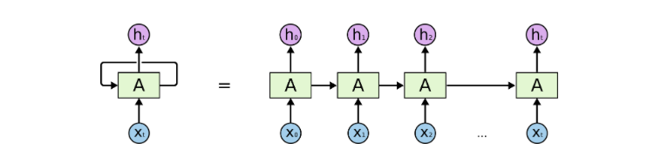
Examples of Deep Learning
Fully connected NN
Convolution NN
Autoencoder NN
Recurrent NN
Machine Learning using Tensorflow
Shu-Ting Pi

Slide 7
Resources of machine learning
Theoretical courses:
  Yaser Abu-Mostafa@ Caltech CS156:
    https://goo.gl/uekMp6
  林軒田 @ NTU
    http://www.csie.ntu.edu.tw/~htlin/mooc/
Balance:
  Andrwe Ng @ Stanford
    https://goo.gl/Cxfxco
Implementation:
  Movan @ Youtuber
    https://morvanzhou.github.io/
Machine Learning using Tensorflow
Shu-Ting Pi

Slide 8
Frameworks of machine learning
Caffe, Caffe2 (C++, Python, Matlab):
  UC Berkeley develop, Light weight, facebook support
DeepLearning4J (Java):
  Skymind develop, super good documentation
CNTK (Python, C++, BrainScripe):
  Microsoft develop
Theano (Python):
  U of Montreal, Most popular in academy, similar to Tensorflow
Torch, Pytorch (Lua, Python):
  Facebook, Twitter,…,etc. Could be the fastest
Machine Learning using Tensorflow
Shu-Ting Pi

Slide 9
Frameworks of machine learning
Tensorflow (Python, C++):
  Google developed, most popular in AI
Keras (Python):
  Encapsulation of Tensowflow, CNTK, Theano, Much easier than Tensorflow
Scikit-learn (Python):
  Colletcion of several ML algorithm, much easier to use, update frequently
Above three libraries will be our main tools to explore ML!
Machine Learning using Tensorflow
Shu-Ting Pi

Slide 10
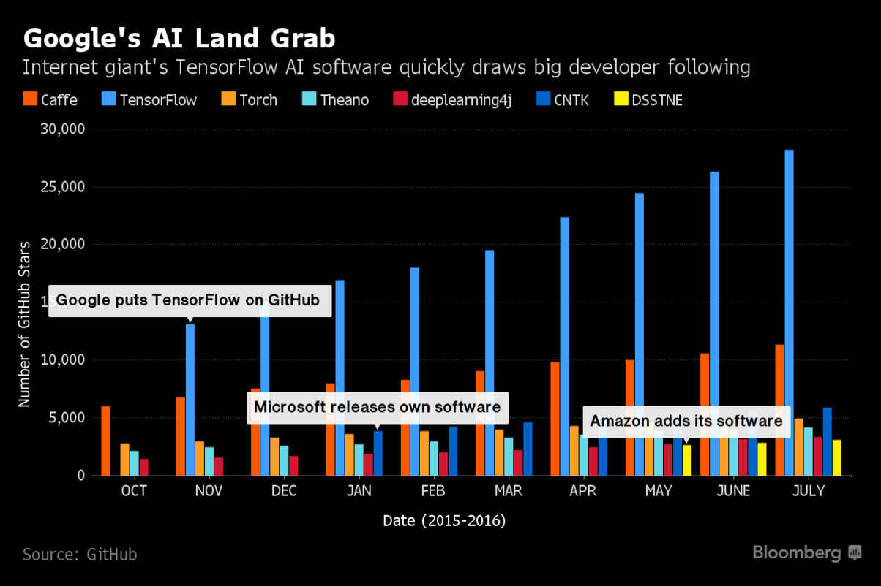
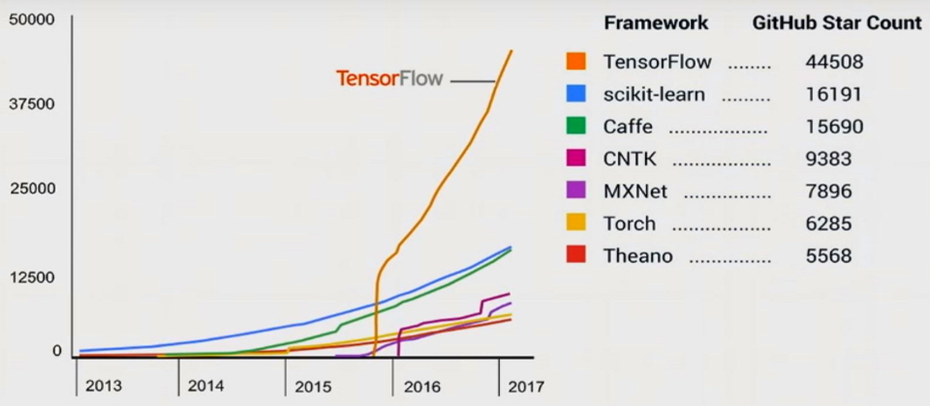
Why do we choose Tensorflow?
Except Tensorflow, we will also focus on sklearn & Keras
Machine Learning using Tensorflow
Shu-Ting Pi

Slide 11
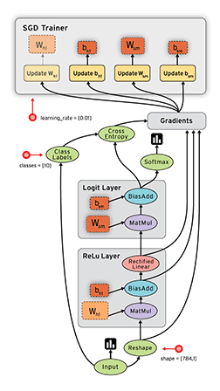
What is Tensorflow?
Developed by Google:
  Voice, Gmail, Photos, Alpha Go,…,etc.
Hardware:
  CPU and GPU, automatically balanced
Computation Graph:
  Users design computation graph
  Tensorflow handles all the others
Rich algorithms:
  Most popular ML algorithms are included.
Machine Learning using Tensorflow
Shu-Ting Pi

Slide 12
Package to install
Anaconda:
  Best and well-maintained python distribution
Protocol Buffer:
  Google’s data record tool. Needed for Tfrecord.
Bazel:
  Google’s Makefile, needed if compile TF from source code.
Tensorflow, scikit-learn, Keras:
  ML tools used in this courses.
Machine Learning using Tensorflow
Shu-Ting Pi

Slide 13
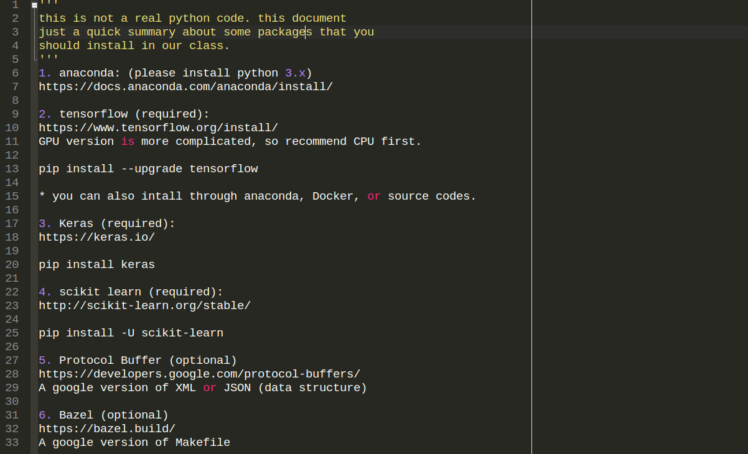
In-Class Exercise
Machine Learning using Tensorflow
Shu-Ting Pi

